Slide 1
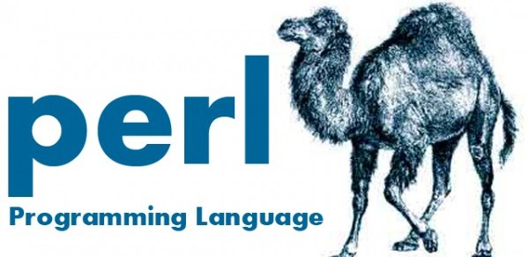
Perl Training - Session 3
Dr. Prabhakar PhD
Senior Integration Engineer
Decision Minds, Bengaluru.

Slide 2
Contents
Control Statements (loops)
Functions - Subroutines
File Handling
Regular Expressions
Previous Session Materials
https://github.com/prabhakarg-dm/Perl-Training-Session1.git
https://github.com/prabhakarg-dm/Perl-Training-Session2.git
https://github.com/prabhakarg-dm/Perl-Training-Session3.git

Slide 3
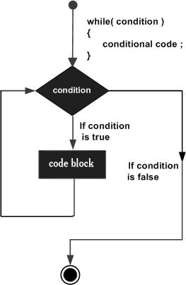
Control Statements Loops
while statement
Syntax: while(condition) {
statement(s);
}
use strict;
use warnings;
my $a = 10;
while( $a < 20 ) {
print "Value of a: $a\n";
$a = $a + 1;
}
Looping statements used for repeating the same operations for predefined number of times.
For example if you want to check if a particular name exists in a file then you can read the file into an array and then iterate it in a for loop to check if the name exists in a file or not
Notes:
Conditional statements are the bread and butter of the programmers, they are useful for checking the conditions

Slide 4
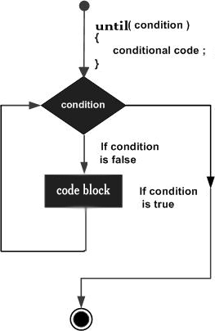
Control Statements Loops
until statement
Syntax: until(condition) {
statement(s);
}
use strict;
use warnings;
my $a = 5;
until( $a > 10 ) {
print "Value of a: $a\n";
$a = $a + 1;
}
Notes:
Conditional statements are the bread and butter of the programmers, they are useful for checking the conditions

Slide 5
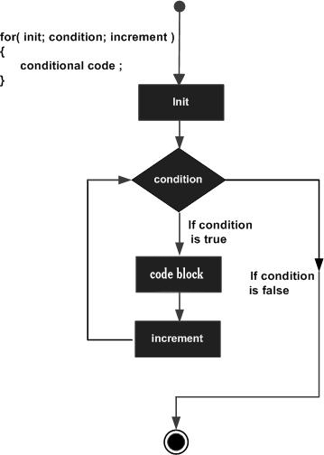
Control Statements Loops
for statement
Syntax: for ( init; condition; increment )
{
statement(s);
}
use strict;
use warnings;
for( $a = 10; $a < 20; $a = $a + 1 )
#for( $a = 10; $a < 20; $a++ )
{
print "value of a: $a\n";
}

Slide 6
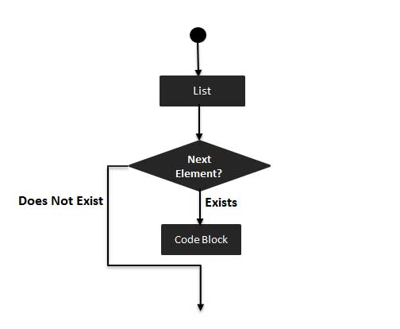
Control Statements Loops
foreach statement
Syntax: foreach var (list) {
...
}
use strict;
use warnings;
my @list = (2, 20, 30, 40, 50);
foreach $a (@list) {
print "value of a: $a\n";
}

Slide 7
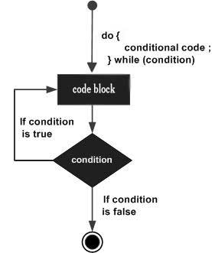
Control Statements Loops
do…while statement
Syntax: do {
statement(s);
}while( condition );
use strict;
use warnings;
$a = 10;
do{
printf "Value of a: $a\n";
$a = $a + 1;
}while( $a < 20 );

Slide 8
Control Statements Loops
Nested loops
do…while
for
while
do{
statement(s);
do{
statement(s);
}while( condition );
}while( condition );
for ( init; condition; increment ) {
for ( init; condition; increment ) {
statement(s);
}
statement(s);
}
while(condition) {
while(condition) {
statement(s);
}
statement(s);
}
until
foreach
until(condition) {
until(condition) {
statement(s);
}
statement(s);
}
foreach $a (@listA) {
foreach $b (@listB) {
statement(s);
}
statement(s);
}

Slide 9
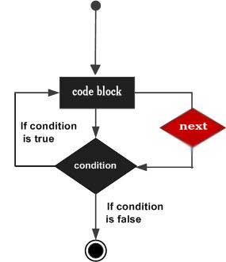
Loop Control Statements
next statement
Syntax: next [ LABEL ];
use strict;
use warnings;
$a = 10;
while( $a < 20 ) {
if( $a == 15) {
# skip the iteration.
$a = $a + 1;
next;
}
print "value of a: $a\n";
$a = $a + 1;
}
next statement skips the current iteration and starts the next iteration of the loop

Slide 10
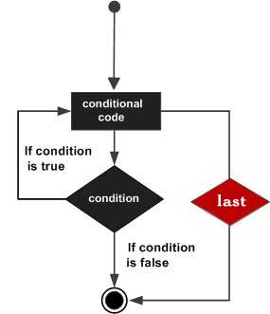
Loop Control Statements
last statement
Syntax: last [ LABEL ];
use strict;
use warnings;
$a = 10;
while( $a < 20 ) {
if( $a == 15) {
# terminate the loop.
$a = $a + 1;
last;
}
print "value of a: $a\n";
$a = $a + 1;
}
Terminates the loop statement and transfers execution to the statement immediately following the loop.

Slide 11
Loop Control Statements
continue statement
Syntax: continue [ LABEL ];
use strict;
use warnings;
my @list = (1, 2, 3, 4, 5);
foreach $a (@list) {
print "Value of a = $a\n";
} continue {
last if $a == 4;
}
use strict;
use warnings;
$a = 0;
while($a < 3) {
print "Value of a = $a\n";
} continue {
$a = $a + 1;
}

Slide 12

Loop Control Statements
redo statement
Syntax: redo [ LABEL ];
use strict;
use warnings;
my @list = (1, 2, 3, 4, 5);
foreach $a (@list) {
print "Value of a = $a\n";
} continue {
last if $a == 4;
}

Slide 13
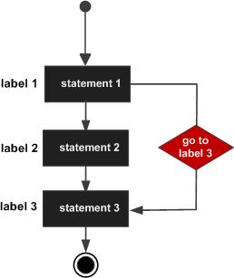
Loop Control Statements
goto statement
Syntax: goto [ LABEL ];
use strict;
use warnings;
$a = 10;
LOOP:do {
if( $a == 15) {
# skip the iteration.
$a = $a + 1;
# use goto LABEL form
goto LOOP;
}
print "Value of a = $a\n";
$a = $a + 1;
} while( $a < 20 );

Slide 14
Functions - Subroutines
Function declaration
Calling a function
Passing parameters
Local variables
Returning values
Syntax: sub subroutine_name {
body of the subroutine
}
….
….
subroutine_name(arguments);
keyword sub
use strict;
use warnings;
# Function definition
sub Hello {
print "Hello, World!\n";
}
# Function call
Hello();
Should be preferably either in the end or in the beginning of the main program to improve readability and also ease in debugging.

Slide 15
Functions – Subroutines - Passing Arguments
use strict;
use warnings;
# Function definition
sub Average {
# get total number of arguments passed.
my $n = scalar(@_);
my $sum = 0;
foreach my $item (@_) {
$sum += $item;
}
my $average = $sum / $n;
print "Average for the given numbers : $average\n";
}
# Function call
Average(10, 20, 30);

Slide 16
Functions – Subroutines - Passing Arrays
use strict;
use warnings;
# Function definition
sub PrintList {
my @list = @_;
print "Given list is @list\n";
}
my $a = 10;
my @b = (1, 2, 3, 4);
# Function call with list parameter
PrintList($a, @b);

Slide 17
Functions – Subroutines - Passing Hashes
use strict;
use warnings;
# Function definition
sub PrintHash {
my (%hash) = @_;
foreach my $key ( keys %hash ) {
my $value = $hash{$key};
print "$key : $value\n";
}
}
my %hash = ('name' => 'Tom', 'age' => 19);
# Function call with hash parameter
PrintHash(%hash);

Slide 18
Functions – Subroutines - Returning Value
use strict;
use warnings;
# Function definition
sub Average {
# get total number of arguments passed.
my $n = scalar(@_);
my $sum = 0;
foreach my $item (@_) {
$sum += $item;
}
my $average = $sum / $n;
return $average;
}
# Function call
my $num = Average(10, 20, 30);
print "Average for the given numbers : $num\n";
The value is returned only if there is an explicit return statement

Slide 19
Function Variables
The variables declared in the main program are by default global so they will continue to have their values in the function also.
use strict;
use warnings;
#Declaring a variable
my $variable = 7777;
# Function definition
sub vary {
my $funvariable = 8888;
print "\nThis variable is declared in main script: $variable\n";
}
# Function call
vary();
print "\nThis variable is declared in the subroutine: $funvariable\n";
Notes:
Most of the time it is not even required to download all the data from the internet, instead just scrap and extract the required data and remove the unnecessary data.

Slide 20
File Handling
Open a file and read the contents of file into an array
use strict;
use warnings;
open(DATA,"<import.txt") or die "Can't open data";
@lines = <DATA>;
print @lines;
close(DATA);
Notes:
Most of the time it is not even required to download all the data from the internet, instead just scrap and extract the required data and remove the unnecessary data.

Slide 21
File Handling
Script to Copy data from one file to another.
use strict;
use warnings;
open(DATA1, "<file1.txt"); # Open file to read
open(DATA2, ">file2.txt"); # Open new file to write
# while(<DATA1>) {
print DATA2 $_;
}
close( DATA1 );
close( DATA2 );
Notes:
Most of the time it is not even required to download all the data from the internet, instead just scrap and extract the required data and remove the unnecessary data.

Slide 22
File Handling
Data Scrubbing.
use strict;
use warnings;
open(DATA1, "<import.txt"); # Open file to read
open(DATA2, ">file2.txt"); # Open new file to write
my @file = <DATA1>;
foreach my $line (@file) {
if ($line =~ /^Data.*/)
{
print DATA2 "$line";
print $line;
}
}
close( DATA1 );
close( DATA2 );

Slide 23
File Handling
Appending Files.
use strict;
use warnings;
open(DATA1, "<import.txt"); # Open file to read
open(DATA2, ">>file2.txt"); # Open new file to write
my @file = <DATA1>;
foreach my $line (@file) {
if ($line =~ /^Line.*/)
{
print DATA2 "$line";
print $line;
}
}
close( DATA1 );
close( DATA2 );

Slide 24
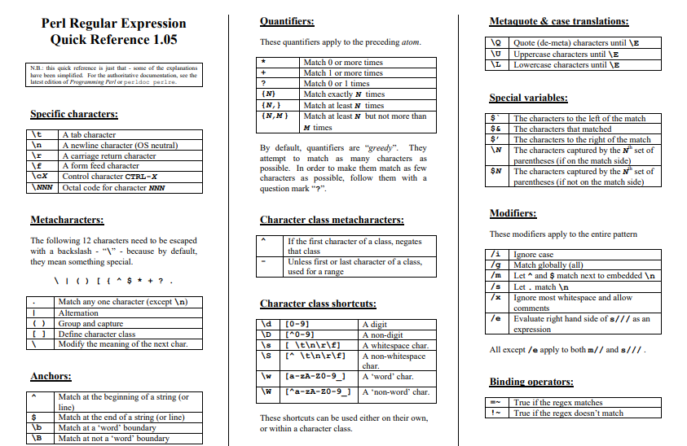
Regular Expressions
Regular Expressions are used for pattern searching and text mining.

Slide 25
Regular Expressions
use strict;
use warnings;
my $str = 'The dog jumped from the green tree';
if ($str =~ /^The.*/)
{ print "The first word is *****The*****\n"; }
if ($str =~ /^The.*tree$/)
{ print "The last word is .....tree.....\n"; }
my $spstr1 = '#The dog jumped from the green tree';
if ($spstr1 =~ /(\#)The.*tree/)
{ print "The special character that exists is $1\n"; }
my $spstr2 = 'The dog jumped from the green ?tree';
if ($spstr2 =~ /\w+.*(\?)tree/)
{ print "The special character that exists is $1\n"; }
!~ negated regex
use strict;
use warnings;
my $str = 'The black cat jumped from the green tree';
if ($str !~ m/dog/)
{
print "There is no dog\n";
}
^ matches beginning of string, $ matches end.
use \ for matching special characters.
^ $ ( ) { } [ ] ? . @ + * / \,

Slide 26
Regular Expressions
substrings
Substitutions
use strict;
use warnings;
my $mystring = "Hello World!";
if($mystring =~ m/World/)
{
print "***Yes\n";
}
#Ignoring case
if($mystring =~ m/world/i)
{
print "---Yes\n";
}
use strict;
use warnings;
my $mystring = "Good Morning!";
$mystring =~ s/Morning/Evening/;
print "$mystring\n";
#Ignoring case
$mystring =~ s/morning/Evening/i;
print "$mystring - case insensitive substituition\n";

Slide 27
Coming up in session 4
Perl packages & modules
CPAN
Object oriented Perl

Slide 28
Thank you

